Slide 1
How to Prepare Court Forms to Request a Hearing Regarding Accounting (Determination of Child Support/Spousal Support Arrears or Unreimbursed Expenses)
SUPERIOR COURT OF CALIFORNIA
COUNTY OF ORANGE
SELF-HELP CENTER/
FAMILY LAW FACILITATOR OFFICE

Slide 2
This document assists you in completing the necessary paperwork for filing a Request for Order Regarding Accounting.
It is recommended that you print a copy of this document first, then use the step-by-step instructions to complete the necessary forms.
You may then use the following links to go directly to the online version of the form, where you may type in the required information and then print the completed forms:
Request for Order: http://www.courts.ca.gov/documents/fl300.pdf
Application to Determine Arrearages: http://www.courts.ca.gov/documents/fl490.pdf
Declaration of Payment History: http://www.courts.ca.gov/documents/fl420.pdf
Payment History Attachment: http://www.courts.ca.gov/documents/fl421.pdf
Declaration Regarding Address Verification: http://www.courts.ca.gov/documents/fl334.pdf
Proof of Service by Mail: http://www.courts.ca.gov/documents/fl335.pdf
Proof of Personal Service: http://www.courts.ca.gov/documents/fl330.pdf
Once you have completed and signed the appropriate forms, file them in the Family Law Clerk’s Office located at the Lamoreaux Justice Center (LJC), 341 The City Drive, Orange, CA 92868, Room 706 on the 7th floor, or the Family Law filing window at the Central Justice Center, 700 Civic Center Drive West, Santa Ana CA 92701.
If you would like someone to review your finished documents for procedural completeness before filing them, you may bring them to the Self-Help Center to schedule a document review appointment.

Slide 3
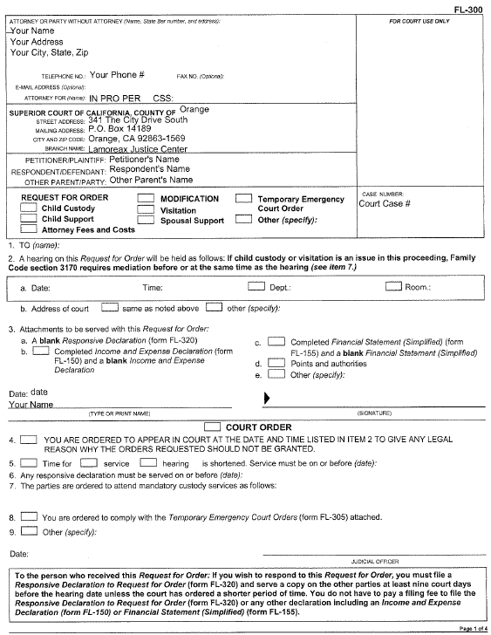
Request for Order – FL-300 (page 1)
You are the “Party Without Attorney.”
Enter your name, street address, city, state, zip code, and phone number here.
You should list the address where you receive mail.

Slide 4
Request for Order (page 1)
“IN PRO PER” means you do not have an attorney and are representing yourself.
If Orange County Child Support Services (CSS) is involved, you will have a CSS case number which should be entered here.

Slide 5
Request for Order (page 1)
Enter the court address information here.

Slide 6
Request for Order (page 1)
Enter the names of Petitioner, Respondent, and Other Parent (if applicable) here.
NOTE: Use another filed document in the case as a reference. The case caption does not change. If you are the Respondent named in the original document filed in the case, you will always be the Respondent, even if you are the one filing the Request for Order.

Slide 7
Request for Order (page 1)
Enter your Orange County Superior Court case number here.

Slide 8
Request for Order (page 1)
Check the boxes for Other.
Enter “Accounting” under the “Other” box.

Slide 9
Request for Order (page 1)
Item 1. Enter the name(s) of the other party(ies) involved in the case.
If CSS is involved, write “County of Orange” and the Other Parent’s name. If the Other Parent has an attorney of record, write “and his/her attorney of record” after the Other Parent’s name.

Slide 10
Request for Order (page 1)
Item 2. Do not enter anything here. When you file your paperwork, the Clerk will fill in the date, time, and department of your hearing.

Slide 11
Request for Order (page 1)
Enter the date, print your name, and sign where indicated.

Slide 12
Request for Order (page 1)
Item 4. Check these boxes.

Slide 13
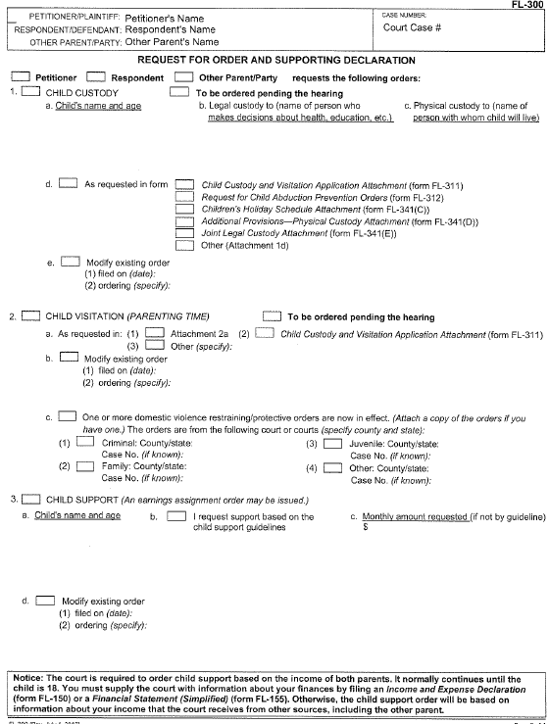
Request for Order (page 2)
Enter the case caption information and case number here (same as on page 1).

Slide 14
Request for Order (page 2)
Check the box identifying the party filing the Request for Order.
There will be no other entries on this page.

Slide 15
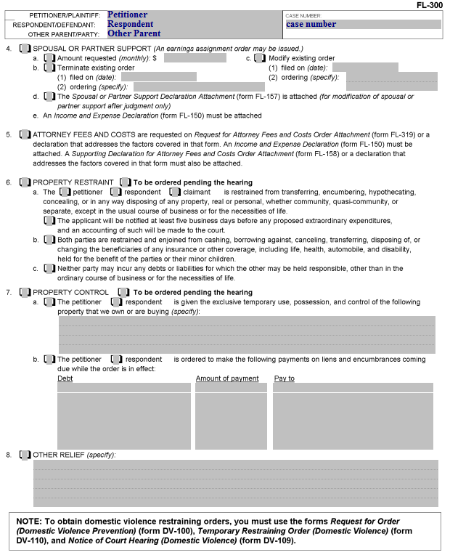
Request for Order (page 3)
Item 8. Check this box and enter “Accounting” in the space provided.
Your Other Relief should match what is listed on page 1.

Slide 16
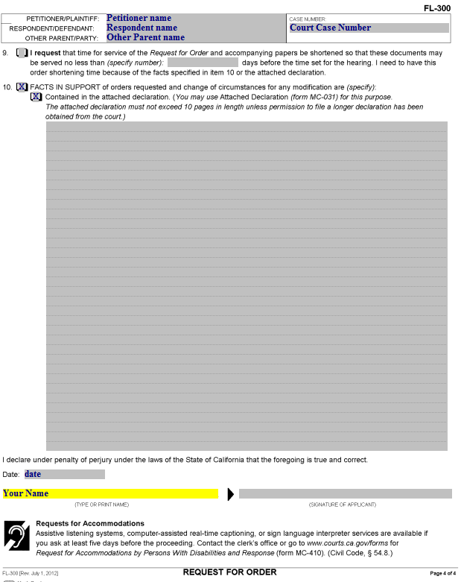
Request for Order (page 4)
Item 10. Check the box for this item.
Facts supporting your request may be written here or on a separate declaration page. If you use a separate declaration page, check the box for “Contained in the attached declaration.”

Slide 17
Request for Order (page 4)
Enter the date, print your name, and sign here.

Slide 18
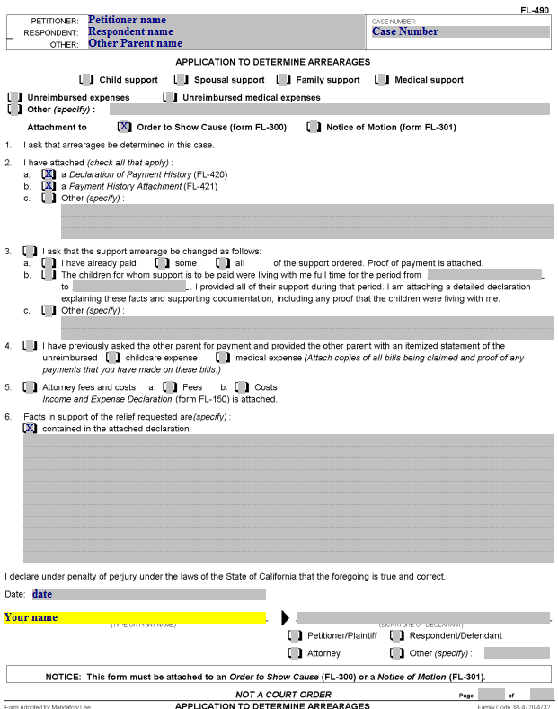
Application to Determine Arrearages – FL-490
Enter the case caption information and case number here (same as on page 1 of the Request for Order).

Slide 19
Application to Determine Arrearages
Check the box(es) for the type(s) of support at issue in your request.

Slide 20
Application to Determine Arrearages
Check these boxes.

Slide 21
Application to Determine Arrearages
Item 6. Enter the facts that support your request. For example, if you are requesting an accounting for unreimbursed medical expenses, you may state the dates you requested the other party to pay his/her share of the expenses and that he/she did not pay them.

Slide 22
Application to Determine Arrearages
Enter the date, print your name, and sign here.

Slide 23
Application to Determine Arrearages
Check the box that identifies your status in the case (if you are the Other Parent, check “Other” and write in “Other Parent”).

Slide 24
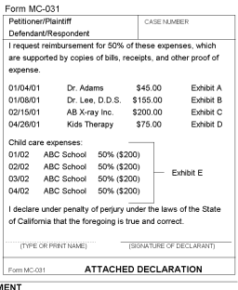
Preparing your supporting documents
Before preparing your Declaration of Payment History and Payment History Attachment, you will need to collect any supporting documentation.
Put your bills and payments in chronological order by date of payment.
If there are more than one bill per month, you will need to attach a declaration grouping the bills as shown on the left.

Slide 25
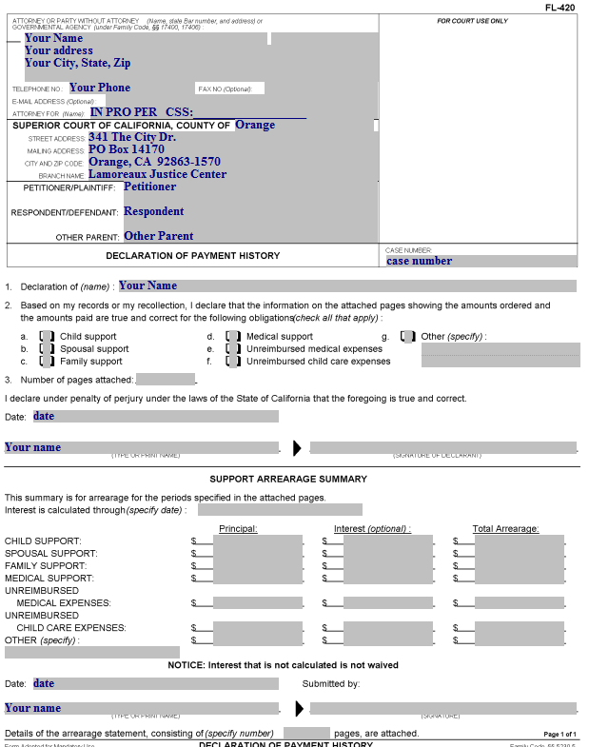
Declaration of Payment History – FL-420 PART 1
This information should be the same as on the Request for Order.
On this form, you will summarize the information provided on the Payment History Attachment(s).

Slide 26
Declaration of Payment History
Item 1. Enter your name here.

Slide 27
Declaration of Payment History
Item 2. Check the box(es) for each type of payment(s) you are seeking.
NOTE: You need to prepare a separate Payment History Attachment for each type of obligation or expense.

Slide 28
Declaration of Payment History
Item 3. Enter the number of attached pages here (this document is page 1, the Payment History Attachment(s) start at page 2, followed by your supporting documents)

Slide 29
Declaration of Payment History
Enter the date, print your name, and sign here.

Slide 30
Declaration of Payment History
Support Arrearage Summary
Complete this section after completing your Payment History Attachment(s).

Slide 31
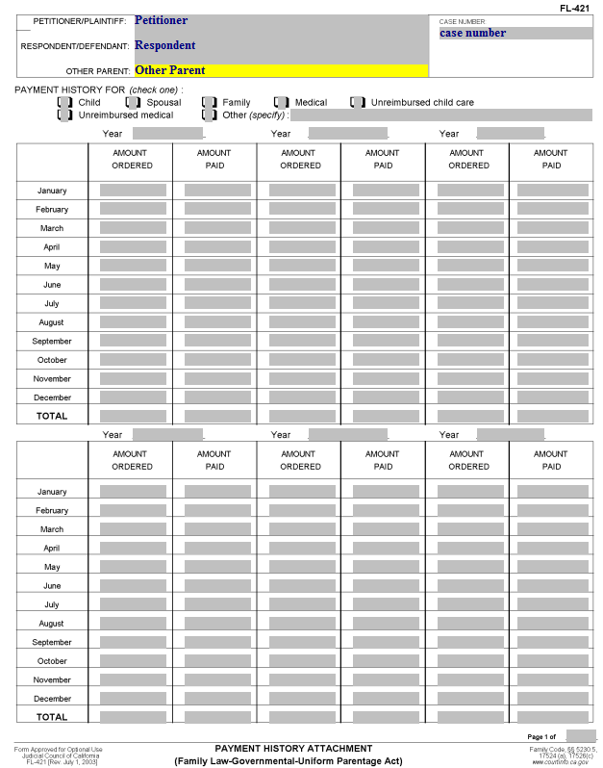
Payment History Attachment – FL-421
This form is used to provide a yearly and monthly breakdown of the amounts ordered, amounts paid by the other parent, and to calculate the amounts owed.
Enter the case caption information and case number here.

Slide 32
Payment History Attachment
Check the box for the type of obligation or expense requested.
Do not combine more than one type of support on one form.

Slide 33
Payment History Attachment
Enter the year here (e.g., 2012).
Six (6) years of information may be shown on a single page.

Slide 34
Payment History Attachment
This column shows the “Amount Ordered.”
For Direct Expenses (e.g., child support or spousal support), enter the amount ordered for each month.
For unreimbursed expenses, enter the total amount paid for each month preceded by “50%” (assuming there is an order for each party to equally share these costs). For example, a bill for $250 would be entered as “50%($250).”

Slide 35
Payment History Attachment
This column shows the “Amount Paid” by the other party - the party from whom you are seeking payment.
If the other party made no payment, enter zero “0” in the same month next to “Amount Ordered.”

Slide 36
Payment History Attachment
For each year, you need to total the “Amount Ordered” and “Amount Paid” columns.
In the TOTAL “Amount Ordered” column, calculate and add up each row for the other parent’s total amount owed.
In the TOTAL “Amount Paid” column, add up each row for the other parent’s total amount paid.
Add up all of the “Amount Ordered” yearly totals. Then add up all of the “Amount Paid” yearly totals.
Subtract the sum of the “Amount Paid” yearly totals from the sum of the “Amount Ordered” yearly totals. This is the amount that will be entered on the Declaration of Payment History.

Slide 37
Declaration of Payment History – PART 2
Information from the Payment History Attachment(s) will be input here.
For each category for which you prepared a Payment History Attachment, enter the total unpaid amount (Total of Amount Ordered minus Total of Amount Paid) here.

Slide 38
Declaration of Payment History
If you do not know the amount of interest owed, enter “+” here.

Slide 39
Declaration of Payment History
Add the “Principal” and “Interest” columns and enter the amount here.

Slide 40
Declaration of Payment History
Enter the date, print your name, and sign here.

Slide 41
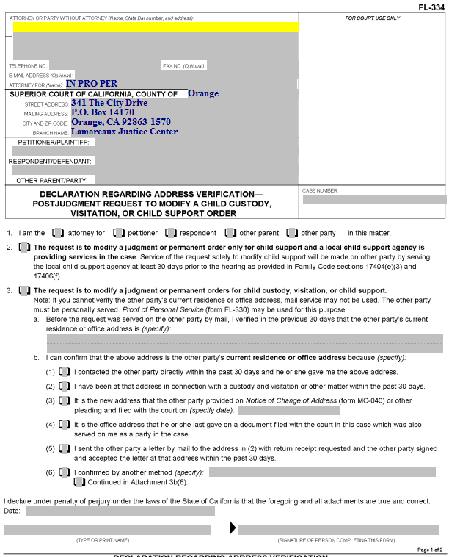
Declaration Regarding Address Verification – FL-334
Complete this form to show the Court that you have verified the address of the person you are serving.
It is required for all Proofs of Service by Mail for documents served after the judgment is entered in a case.

Slide 42
Declaration Regarding Address Verification
Enter your information here.

Slide 43
Declaration Regarding Address Verification
Enter the names of Petitioner, Respondent, and Other Parent (if applicable) here.

Slide 44
Declaration Regarding Address Verification
Enter the Orange County Superior Court case number here.

Slide 45
Declaration Regarding Address Verification
Item 1. Check the box that represents who you are in the case.

Slide 46
Declaration Regarding Address Verification
Item 2. Check this box if your Request for Order is regarding child support only and CSS is involved in your case.

Slide 47
Declaration Regarding Address Verification
Item 3. Check this box if you did not check Item 2.

Slide 48
Declaration Regarding Address Verification
Item 3.a. Enter the address of the party who is being served by mail here.

Slide 49
Declaration Regarding Address Verification
Item 3.b. Check one of these boxes to indicate how you know the service address is correct. If you check (6), describe the method used to confirm the address. If you need more space, attach a page labeled “Attachment 3b(6).”

Slide 50
Declaration Regarding Address Verification
Enter the date, print your name, and sign here.

Slide 51
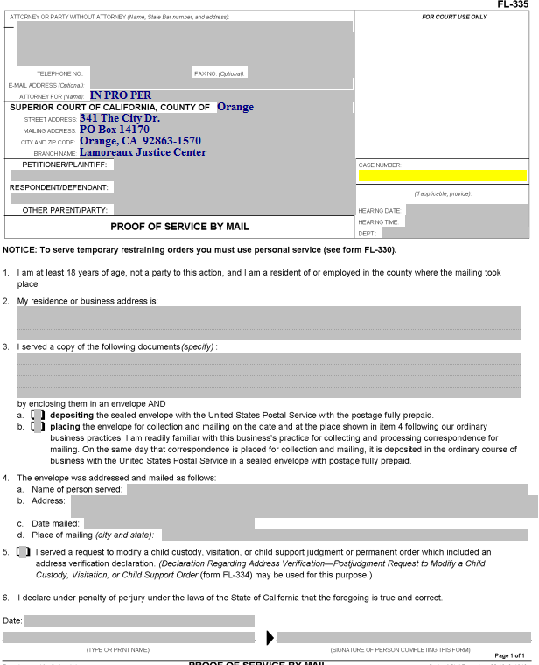
Proof of Service by Mail – FL-335
Someone over the age of 18 who is not a party to the case needs to perform your actual service for you (i.e., placing a copy of the filed documents into a postal mail box).
California law does not permit you to do your own service.
That person – the “server” – will complete the form, which you must then have filed with the Court.

Slide 52
Proof of Service by Mail
Enter your information, case name, and case number here.

Slide 53
Proof of Service by Mail
Enter the date, time, and department (courtroom) for the hearing here.

Slide 54
Proof of Service by Mail
Item 2. The server enters his/her address here.

Slide 55
Proof of Service by Mail
Item 3. Enter the title(s) of the document(s) served on the other party here (e.g., Request for Order and Supporting Declaration, Income and Expense Declaration, blank responsive pleadings).

Slide 56
Proof of Service by Mail
Item 3.a and b. The server will check one of these two boxes, depending on how the documents are mailed.

Slide 57
Proof of Service by Mail
Item 4.a. Enter the name of the person to whom the documents were mailed here.

Slide 58
Proof of Service by Mail
Item 4.b. Enter the address where the documents were mailed here.

Slide 59
Proof of Service by Mail
Item 4.c. The server enters the date on which the documents were mailed here.

Slide 60
Proof of Service by Mail
Item 4.d. The server enters the city and state where the documents were mailed here.

Slide 61
Proof of Service by Mail
Item 5. This box is checked if a Declaration Regarding Address Verification was completed and filed. A copy of that Declaration should be attached to the Proof of Service.

Slide 62
Proof of Service by Mail
The server dates, prints his/her name, and signs here.
The Proof of Service must then be filed with the Court.

Slide 63
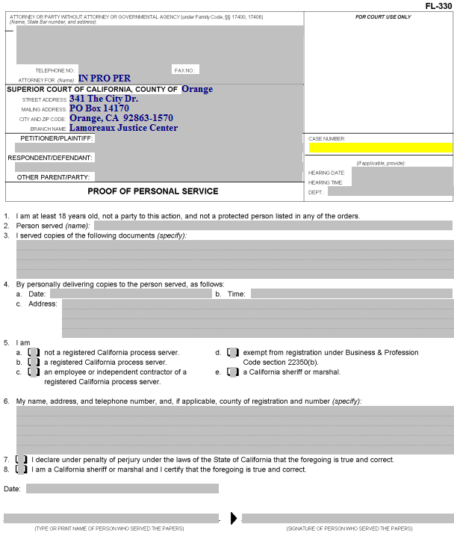
Proof of Personal Service – FL-330
Someone over the age of 18 who is not a party to the case needs to do your actual service for you.
California law does not permit you to do your own service.

Slide 64
Proof of Personal Service
Enter your information, case name, and case number here.

Slide 65
Proof of Personal Service
Enter the date, time, and department (courtroom) for the hearing here.

Slide 66
Proof of Personal Service
Item 2. The server enters the name of the person served here.

Slide 67
Proof of Personal Service
Item 3. Enter the title(s) of the document(s) being served on the other party here (e.g., Request for Order, Income and Expense Declaration, blank responsive pleadings).

Slide 68
Proof of Personal Service
Item 4. The server enters the date, time, and address where the other party was served here.

Slide 69
Proof of Personal Service
Item 5. Check the box that describes the server (usually “a” is checked).

Slide 70
Proof of Personal Service
Item 6. The server enters her/his name, address, and telephone number here.

Slide 71
Proof of Personal Service
Item 7. If the server is not a California sheriff or marshal, check this box.

Slide 72
Proof of Personal Service
The server dates, prints his/her name, and signs here.

Slide 73
Next Steps
After you have completed all of your documents, you will need to make copies as follows:
The original is filed with the Court.
One copy is for your records.
Another copy is for the other party in the case.
If CSS is involved, you will need an additional copy for the agency.
If the other party has an attorney of record, you will need an additional copy for the attorney.
You are ready to schedule a document review at the Self-Help Center or go directly to the Clerk’s Office to file your documents.
You will file your documents in the Clerk’s Office at the Lamoreaux Justice Center (7th Floor, Room 706) or the Family Law Window at the Civil Clerk’s office at the Central Justice Center.

